Slide 1

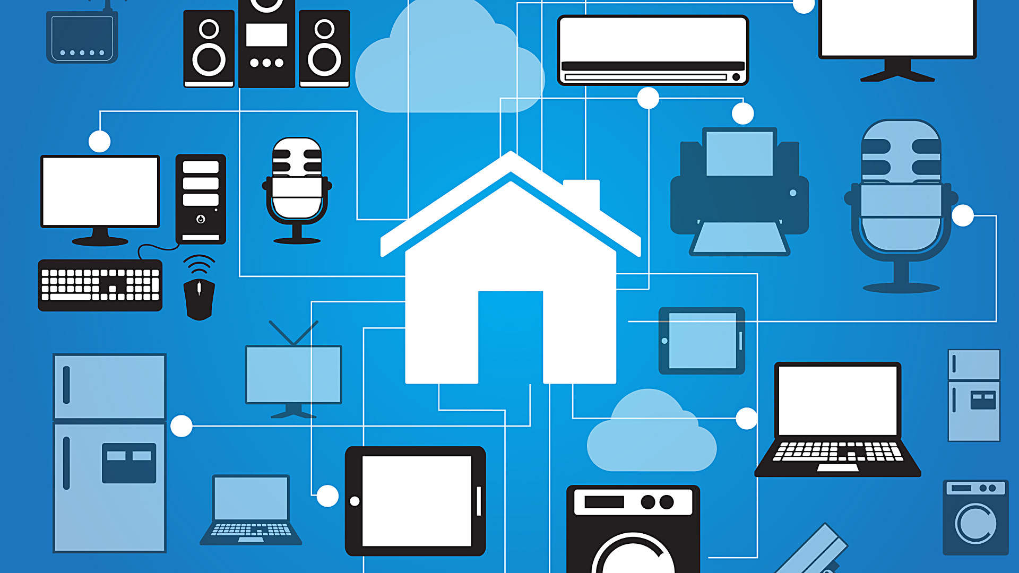

GUI BASED HOME AUTOMATION USING MATLAB AND ARDUINO WITH ANDROID APP AND VOICE CONTROL
ELECTRICAL & ELECTRONICS ENGINEERING SOCIETY SUMMER PROJECT PROGRAM 2017
ABHINAV ANAND
BE/10244/16

Slide 2
“ Any sufficiently advanced technology is indistinguishable from magic. ”
- Arthur C. Clarke

Slide 3
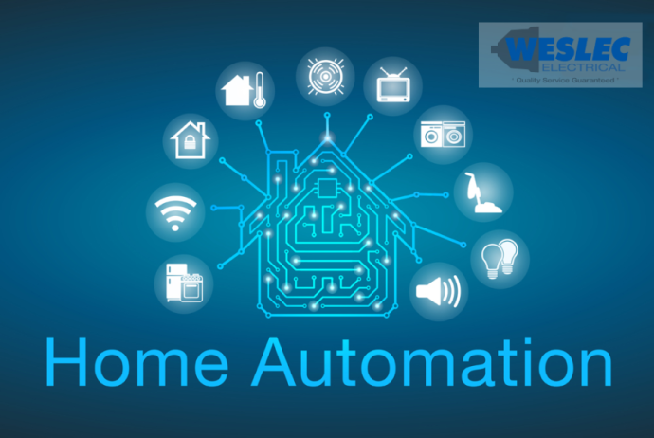
INTRODUCTION
From the beginning of civilization, the majority of inventions that have been done were for the simple reason of improving quality of life of humanity.
Be it the wheel, telegram or an airplane, at their heart the inventors who have shaped our daily lives had the sole purpose of giving us a better and more comfortable life.
This was the cornerstone of ‘Home Automation’.

Slide 4
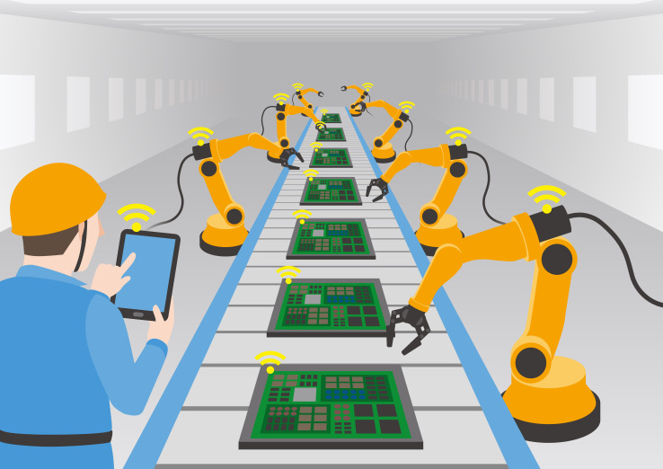
AUTOMATION
Automation is the ability of machines to perform optimum work without the interference of man.
It is the use of advanced electronics, IoT (internet of things), and artificially intelligent programs to ease the daily grind of humans be it in a factory, warehouse or homes.

Slide 5
INTERNET OF THINGS
Internet of Things represents a general concept for the ability of network devices to sense and collect data from the world around us, and then share that data across the Internet where it can be processed and utilized for various interesting purposes.
The IoT refers to the connection of devices (other than typical fare such as computers and smartphones) to the Internet. Cars, kitchen appliances, and even heart monitors can all be connected through the IoT.

Slide 6
STAGES OF HOME AUTOMATION
MATLAB GUI BASED CONTROL
ANDROID APP CONTROL
VOICE CONTROL

Slide 7
MATLAB GUI BASED HOME AUTOMATION
PHASE 1
The GUI is Created using GUIDE (Graphic User Interface Development environment).
GUIs (also known as graphical user interfaces or UIs) provide point-and-click control of software applications, eliminating the need to learn a language or type commands in order to run the application.
A specific program (adioes.pde) has to be uploaded to the Arduino board to enable control of Arduino through MATLAB.

Slide 8
COMPONENTS USED IN PROJECT
2 ARDUINO UNO R3 Boards
1602a 16X2 LCD screen
9 volts DC motor
3 LED
DHT11 temperature and humidity sensor
TIP 122 transistor and N4007 diode for PWM
HC-05 Bluetooth module
22k potentiometer (for LCD contrast)

Slide 9
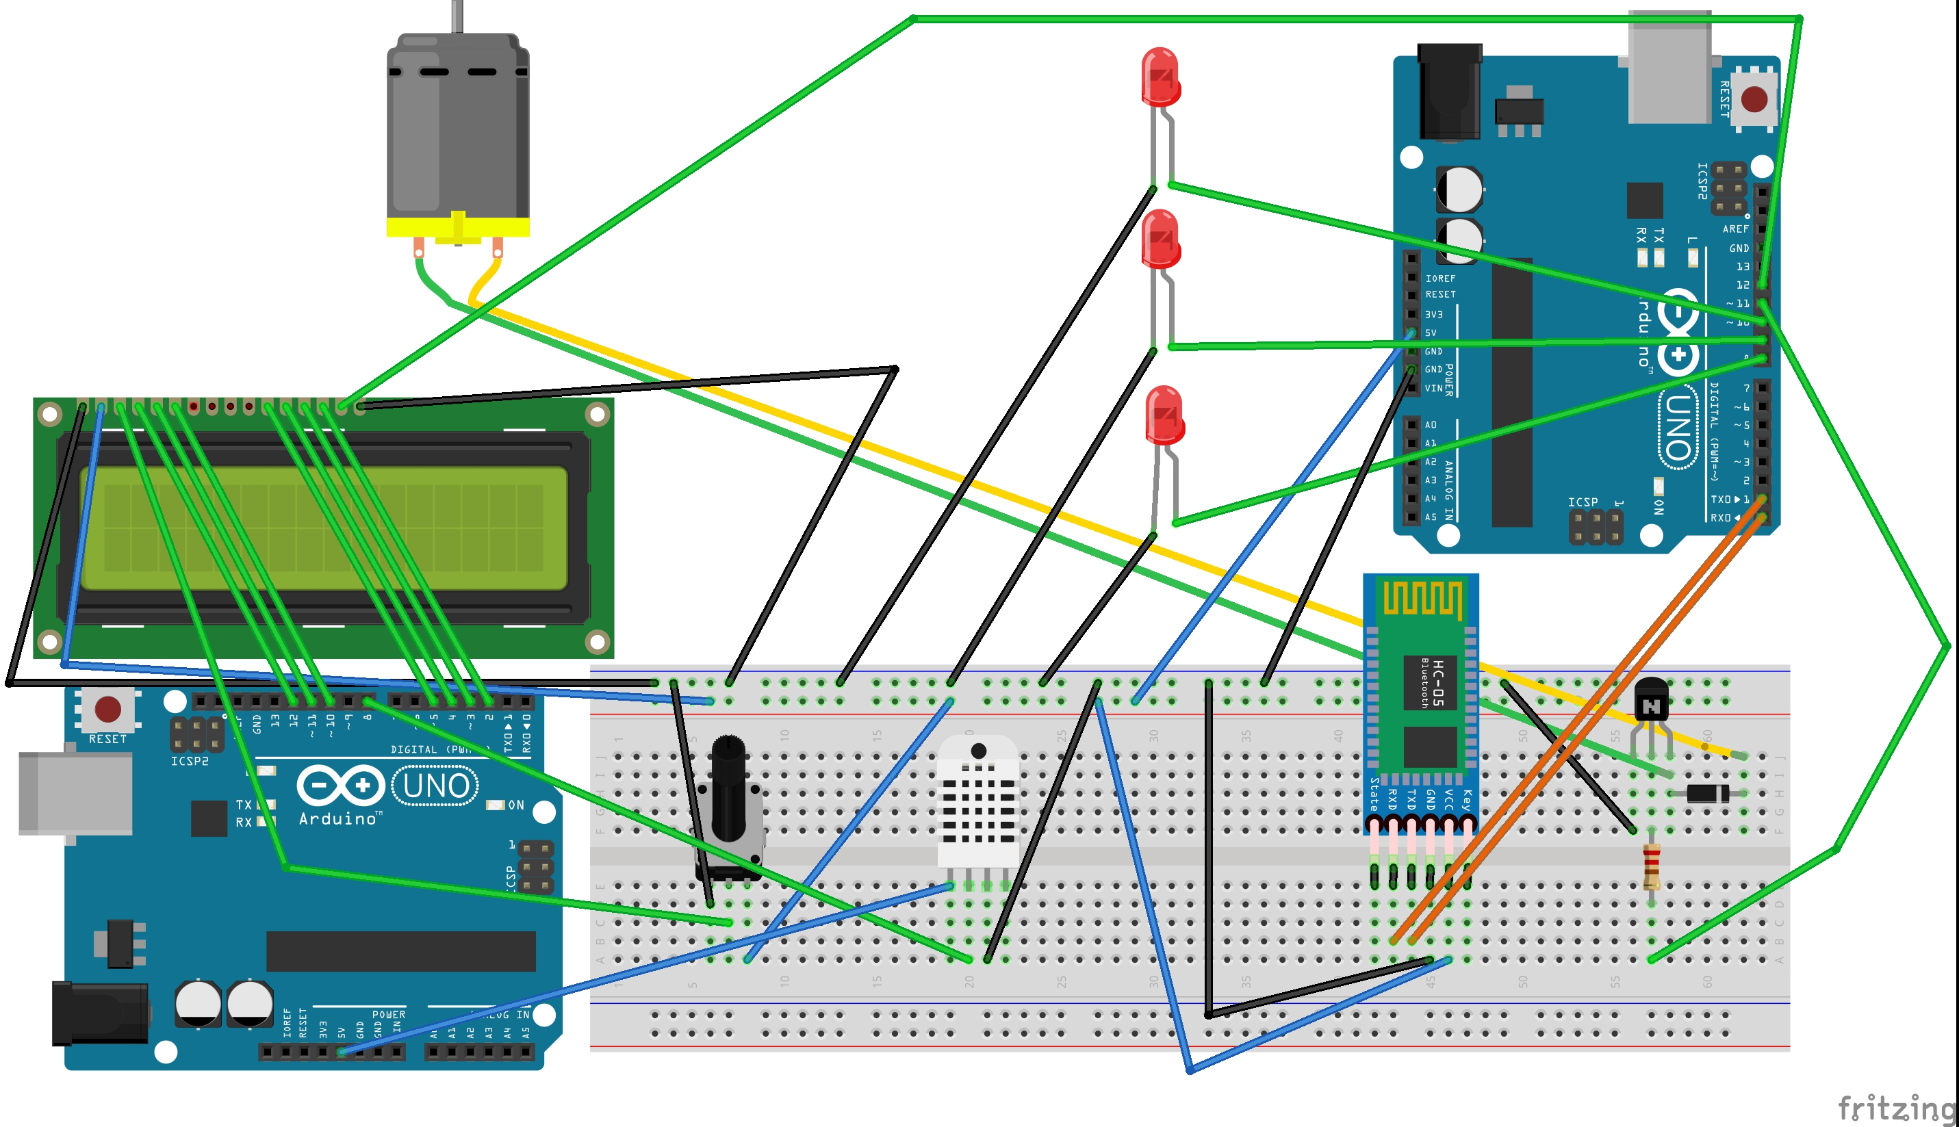
FRITZING SKETCH OF THE PROJECT

Slide 10
MATLAB CODE
clear all;
global c;
global p;
global q;
global r;
global s;
global t;
global u;
c=arduino('COM6');
c.pinMode(8,'output');
c.pinMode(9,'output');
c.pinMode(10,'output');
c.pinMode(11,'output');
c.pinMode(12,'output');
p=0;
q=0;
r=0;
s=0;
t=0;
u=0;

Slide 11
Callback for pushbutton with digital output
function pushbutton2_Callback(hObject, eventdata, handles)
global c;
global p;
global q;
global r;
global s;
global t;
global u;
c.digitalWrite(8,1);
p=36;
u=p+q+r+s+t;
textLabel = sprintf('%f', u);
set(handles.text2, 'String', textLabel);

Slide 12
Callback for pushbutton with analog output
function varargout = THE_GUI_OutputFcn(hObject, eventdata, handles)
varargout{1} = handles.output;
function pushbutton10_Callback(hObject, eventdata, handles)
global c;
global p;
global q;
global r;
global s;
global t;
global u;
c.analogWrite(11,0);
t=0;
u=p+q+r+s+t;
textLabel = sprintf('%f', u);
set(handles.text2, 'String', textLabel);

Slide 13
CODE FOR ARDUINO 2
#include <LiquidCrystal.h>
#include "DHT.h"
#define DHTPIN 8
LiquidCrystal lcd(12, 11, 5, 4, 3, 2);
#define DHTTYPE DHT11
DHT dht(DHTPIN, DHTTYPE);
void setup() {
lcd.begin(16, 2);
dht.begin();
lcd.print("Temp: Humidity:");
}
void loop() {
delay(500);
lcd.setCursor(0, 1);
float h = dht.readHumidity();
float f = dht.readTemperature(true);
if (isnan(h) || isnan(f)) {
lcd.print("ERROR");
return;
}
lcd.print(f);
lcd.setCursor(7,1);
lcd.print(h);
}

Slide 14



ANDROID APP BASED CONTROL
PHASE 2
Blynk is a Platform with iOS and Android apps to control Arduino, Raspberry Pi and other similar boards over the Internet or Bluetooth.
The Blynk app for this project uses Bluetooth as its communication media.
The Arduino board is made capable of bluetooth serial communication by the use of an HC-05 module.

Slide 15
Working of the Android App
First of all the code provided upon the creation of a Blynk app by the blynk website is uploaded to the Arduino board.
Then the app is started in the android mobile
The Bluetooth connections to the board is made from within the app
The buttons in the app are used to operate the Arduino board

Slide 16
ARDUINO CODE FOR APP CONTROL
#define BLYNK_PRINT Serial
#include <SoftwareSerial.h>
SoftwareSerial SwSerial(2, 3); // RX, TX
#include <BlynkSimpleSerialBLE.h>
#include <SoftwareSerial.h>
char auth[] = "bcb194fa906e4bb2baee1b922f53d065";
SoftwareSerial SerialBLE(2, 3); // RX, TX

Slide 17
void setup()
{
Serial.begin(9600);
SerialBLE.begin(9600);
Blynk.begin(SerialBLE, auth);
Serial.println("Waiting for connections...");
}
void loop()
{
Blynk.run();
}

Slide 18

VOICE CONTROL USING ANDROID
PHASE 3
In this phase, the Arduino board is controlled using voice command given by the user
The voice command is first converted into text format and then sent over to the Bluetooth module HC-05 which then sends it to the arduino board via serial port communication.
The speech-to-text conversion is achieved with the help of an android app called AMR VOICE

Slide 19
WORKING OF VOICE CONTROL PHASE
All smartphones have an in-built speech-to-text conversion feature
AMR Voice uses the feature to convert the voice command into a string which starts with ‘*’ and ends with a ‘#’ to mark the start and end points of the command.
This command is sent to the HC-05 module which sends it to the board
Voice command: Command sent to board:
Light ON *light on#

Slide 20
ARDUINO CODE
String voice;
int led1 = 8;
int led2 = 9;
int led3 = 10;
int lcd = 12;
int motor = 11;
void allon() {
digitalWrite (led1, HIGH);
digitalWrite (led2, HIGH);
digitalWrite (led3, HIGH);
digitalWrite (lcd, HIGH);
analogWrite (motor, 255);
}
void alloff() {
digitalWrite (led1, LOW);
digitalWrite (led2, LOW);
digitalWrite (led3, LOW);
digitalWrite (lcd, LOW);
analogWrite (motor, 0);
}
void led1on() {
digitalWrite (led1, HIGH);
}
void led1off() {
digitalWrite (led1, LOW);
}
void led2on() {
digitalWrite (led2, HIGH);
}
void led2off() {
digitalWrite (led2, LOW);
}
void led3on() {
digitalWrite (led3, HIGH);
}
void led3off() {
digitalWrite (led3, LOW);
}
void lcdon() {
digitalWrite (lcd, HIGH);
}
void lcdoff() {
digitalWrite (lcd, LOW);
}

Slide 21
void lcdoff() {
digitalWrite (lcd, LOW);}
void motorlow()
{
analogWrite(motor, 60);}
void motormid()
{
analogWrite(motor, 140);}
void motorhigh()
{
analogWrite(motor, 255);}
void motoroff()
{
analogWrite(motor, 0);}
void setup() {
Serial.begin(9600);
pinMode(led1, OUTPUT);
pinMode(led2, OUTPUT);
pinMode(led3, OUTPUT);
pinMode(lcd, OUTPUT);
pinMode(motor, OUTPUT);
}
void loop() {
while(Serial.available()) {
delay(10);
char c=Serial.read();
if(c=='#')
{break; }
voice += c;
}
if (voice.length() > 0) {
Serial.println(voice);
if (voice == "*all on")
{allon() ; }
if (voice == "*light one on")
{led1on() ; }
if (voice == "*light to on")
{led2on() ; }
if (voice == "*light 3 on")
{led3on() ; }
if (voice == "*light one of")
{led1off() ; }
if (voice == "*light to of")
{led2off() ; }
if (voice == "*light 3 of")
{led3off() ; }
if (voice == "*LCD on")
{lcdon() ; }

Slide 22
if (voice == "*LCD of")
{lcdoff() ; }
if (voice == "*fan speed minimum")
{motorlow() ; }
if (voice == "*fan speed medium")
{motormid() ; }
if (voice == "*fan speed maximum")
{motorhigh() ; }
if (voice == "*fan on")
{motorhigh() ; }
if (voice == "*fan of")
{motoroff() ; }
else if (voice == "*all of")
{alloff() ; }
voice="";
}}

Slide 23
RECENT PROGRESS IN THIS FIELD
Various companies in India like Grey orange, Cubical, Home brain etc. are making home and industrial automation a commercial and profitable business rather than a luxury and rare thing as it was thought to be.
According to research firm Red Seer Consulting, the home automation market in India is expected to reach 3.2 billion $ by 2017. The firm’s report says that the key growth drivers for this demand are increasing consumer awareness and purchasing power.
Increasing data thefts, burglaries, demand for enhanced security, need for energy management / conversion are a few of the key factors that have spurred the India automation and control systems market.

Slide 24
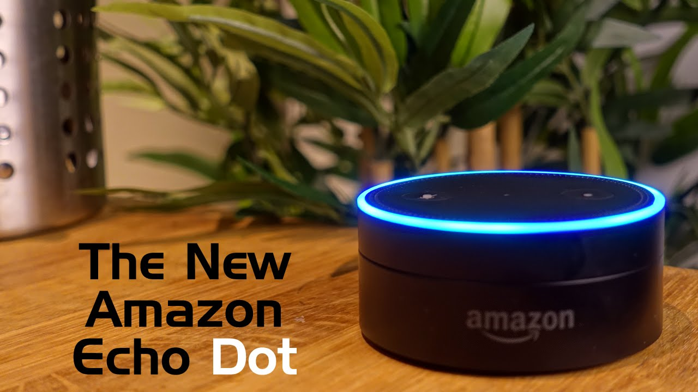
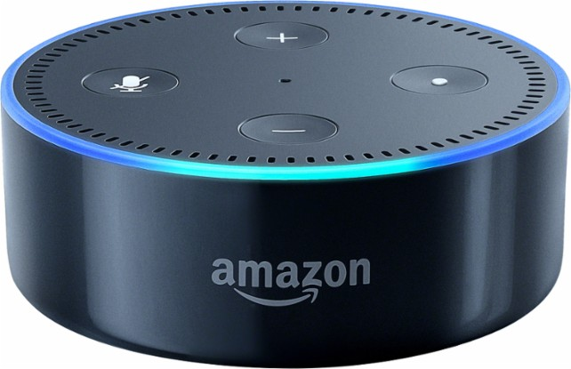
With the release of Amazon Echodot, which is an artificially intelligent home automation system designed for the elderly and disabled, this line of research has become the new trend.

Slide 25
THANK YOU

